Slide 1
FIND A NEIGHBORHOOD IN TEXAS TO PURCHASE A HOME
By olufunmi olugbode

Slide 2
Introduction
In today’s world, many companies and organization collect a lot of data with the aim to extract useful information, recognize patterns and make decisions. Similarly, this project will employ the use of data and python code to make decisions on one of my personal projects such as purchasing a home.

Slide 3
Business Problem
There are many factors to consider when purchasing a house, budget being one of the controlling factor. However, for this exercise, the many other additional considerations to make when looking for a home such as safety, economics, school district and lifestyle would be considered.

Slide 4
Data sources
Most of the information is sourced from statistics within the past 5 to 6 years (2014 – 2020) and is detailed as:
Texas Crime Statistic: Information is taken from the FBI website for the year 2016
Source: https://ucr.fbi.gov/crime-in-the-u.s/2016/crime-in-the-u.s.-2016/tables/table-6/table-6-state-cuts/texas.xls
Texas School District: Information is taken from the Texas Education Agency assessments for the 2018-2019 school year.
Source: https://www.schooldigger.com/go/TX/cityrank.aspx?t=name
Neighborhood: Median household income is sourced from U.S. Census Bureau, American Community Survey (ACS) and Puerto Rico Community Survey (PRCS) for a 5 year estimate. The median income considers inflation and estimates the household income for 2018.
Source: https://www.indexmundi.com/facts/united-states/quick-facts/texas/median-household-income/cities#table
Proximity to shopping, services and/or leisure activities: Foursquare API will be used to leverage location data to find venues related to the neighborhood.
Geospatial Coordinates: sourced from maps of the world.
Source: https://www.mapsofworld.com/usa/states/texas/lat-long.html

Slide 5
Data cleaning
Data cleaning involves fixing incorrect, corrupted, incorrectly formatted, duplicate or incomplete data within a dataset. In addition, removing data that does not belong in the dataset. Data cleaning for this project involves mostly removing data that is not relevant to the business problem. The following functions were applied to clean the data:
Deleting irrelevant columns and rows: using the drop() function
Changing header titles: using the rename() function
Dropping null value columns to avoid errors: using the dropna() function
Selecting specific rows: using the iloc() function
New data frame with split value columns: using string split() function

Slide 6
Methodology
Importing Data
Web Scraping
CSV
Data Cleaning
Data Visualization
Generating Graphs – Bar Plot
Foursquare API
Folium
K means

Slide 7
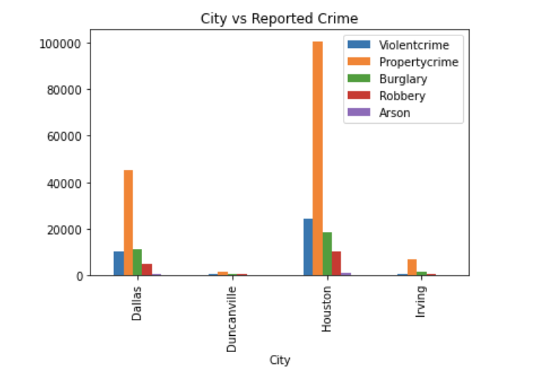
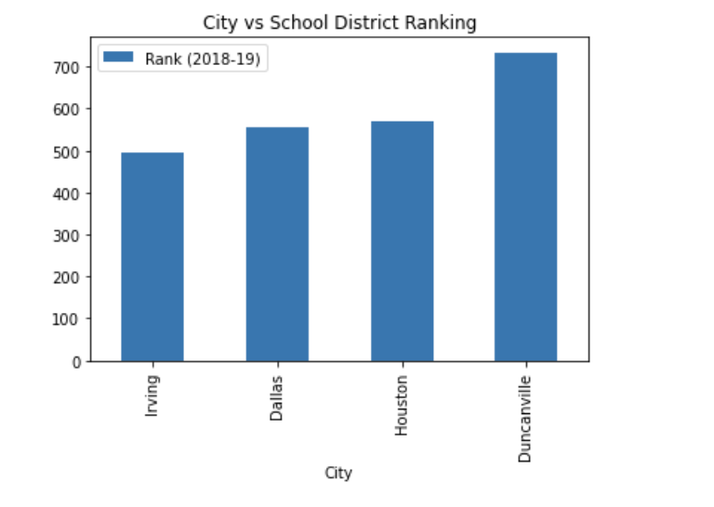
Results
Regarding safety, Houston is a concern.
Irving has a better educational performance, however, private school can meet requirements.

Slide 8
Results cont’d
Households in Duncanville, TX have a median annual income of 55,224 US dollars in 2018 which is comparable to the income in Houston but less than the median annual income of 60,293 US dollars across the entire United States. This was surprising considering that population in Duncanville is considerably less than Dallas and fewer establishments are located here.
Since the crime rate was a concern in the Houston area, comparable educational performance and comparable median income, a decision was made to remove the Houston dataset before considering the venues in the neighborhood.

Slide 9
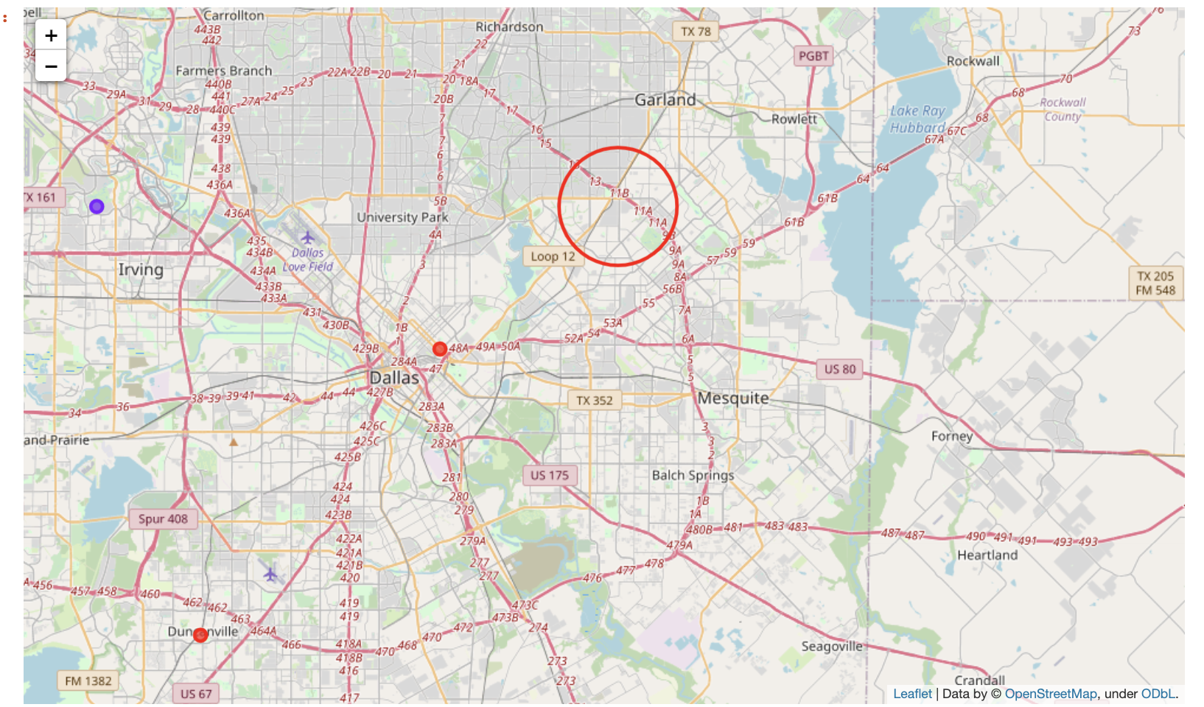
Results cont’d
Plots shows the optimum location is in the Dallas area.

Slide 10
Conclusion
There are many factors to consider when purchasing a house, budget being one of the controlling factor. However, for this exercise, the many other additional considerations to make when looking for a home such as safety, economics, school district and lifestyle would be considered.
The data collected and the analysis gives some confidence in deciding what Texas city to purchase a home which is within the Dallas city limits. This allows for proximity to the social life I desire.
Note that I am better informed about these Texas cities prior to carrying out this study, of course, with more dataset more can be discovered.

